Slide 1
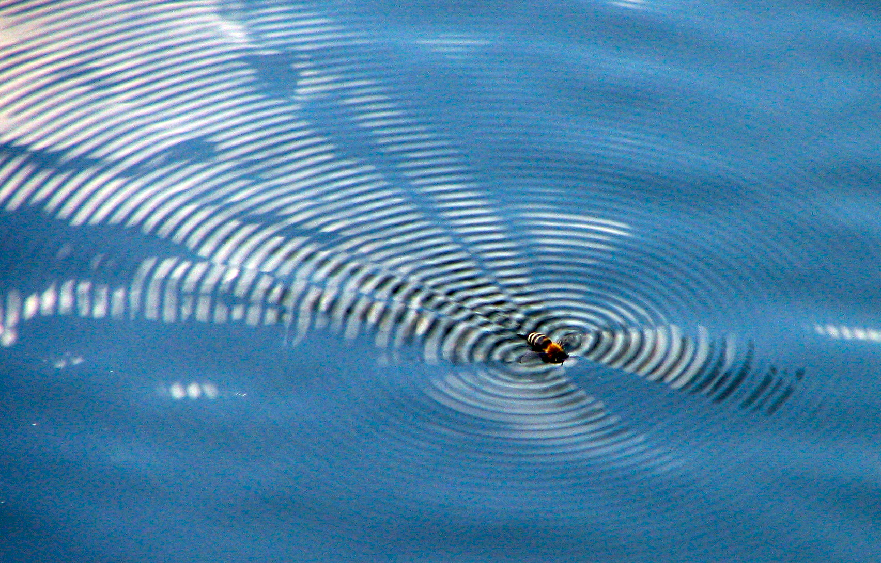
Wave Interactions
This lesson will introduce you to how wave interfere
You will also learn how to apply the principle of superposition to determine the exact shape of the wave form when waves interfere.

Slide 2
Learning Goals
By the end of this lesson, you will be able to:
explain constructive and destructive interference
apply superposition to draw wave interference
explain fixed end and free end reflection
explain standing waves
solve problems involving standing waves

Slide 3
Success Criteria
Can I:
explain constructive and destructive interference
apply superposition to draw wave interference
explain fixed end and free end reflection
explain standing waves
solve problems involving standing waves

Slide 4
Wave Interference
When two waves interact, certain changes in the amplitude of the wave take place. We call this wave interference
Interference is the result of two or more waves meeting each other at a particular point in space at the same time.
There are two types of interference:
Constructive Interference.
Destructive Interference.

Slide 5
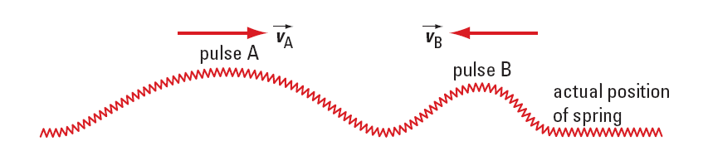
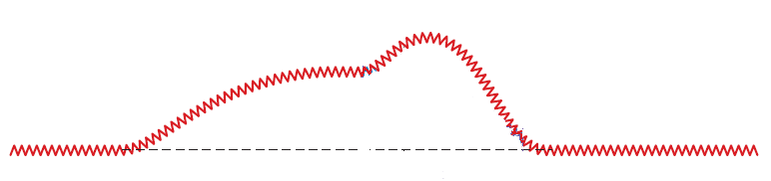
Constructive interference occurs when two crests or two troughs come together to produce a super-crest or a super-trough.

Slide 6
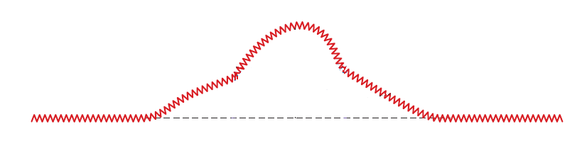
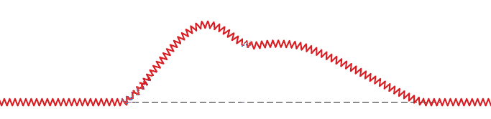
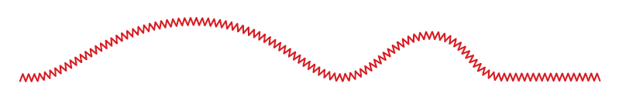
A similar situation occurs when two troughs come together.

Slide 7
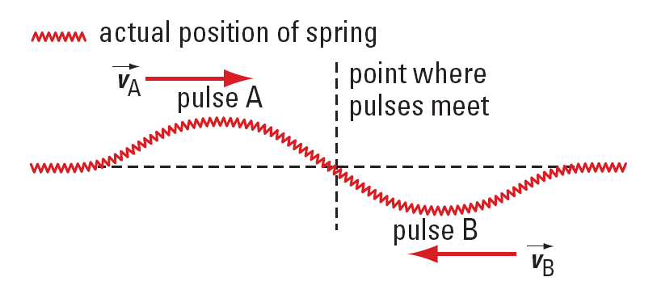
Destructive interference occurs when a crest meets a trough. The result is a momentary decrease in the amplitude of the wave.

Slide 8
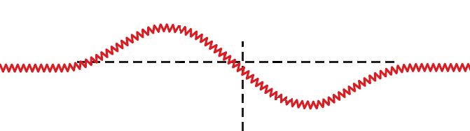
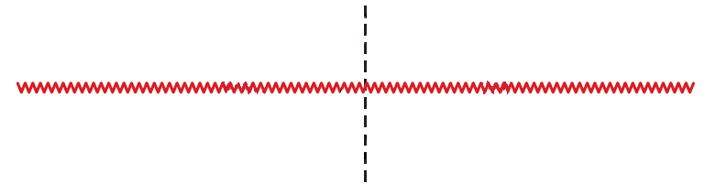
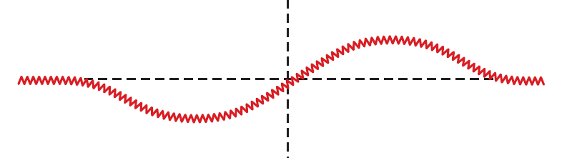

Slide 9
click to play animation

Slide 10
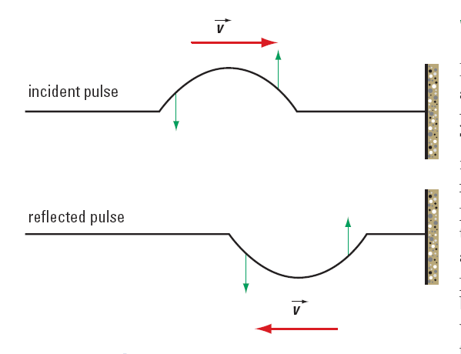
Fixed and Free End Reflection
If a slinky is fixed at one end and a wave reflects off that fixed end, the reflected wave will invert.

Slide 11
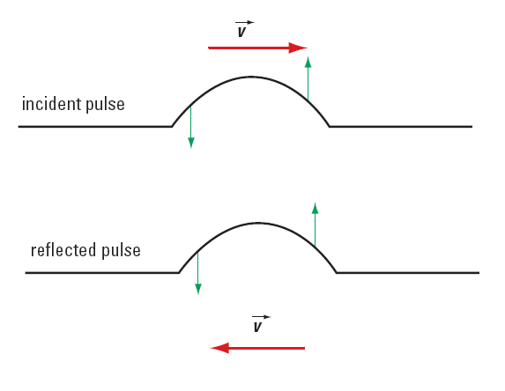
If a slinky is free to move at one end and a wave reflects off that free end, the reflected wave will not invert.

Slide 12
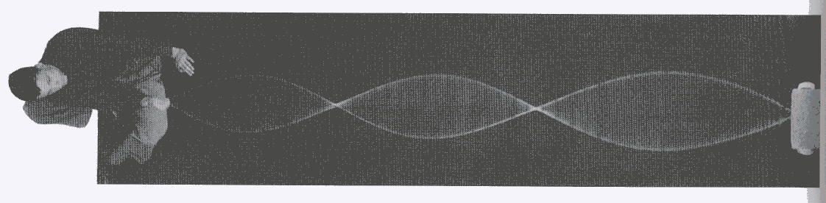
Standing Waves
A standing wave occurs when a particular wave reflects back on itself with the same frequency, wavelength, and speed.
In a standing wave, both constructive and destructive
interference occur. This results in areas of no vibration
and areas of maximum vibration

Slide 13
click to play animation

Slide 14
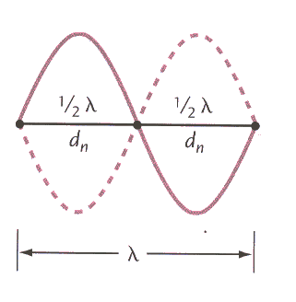
Antinodes
Nodes
the distance between nodes,
which is called the inter-nodal
distance d_{n}, is equal to one-half
the wavelength.

Slide 15
Sample Problem
A standing wave has a distance of 45 cm between four consecutive nodes. The frequency of the source producing the standing wave is 30. Hz. What is
a. the wavelength of the wave?
b. the speed of the wave?
Sol’n a:
Since we have four nodes, there are three
inter-nodal distances, so d_{n} = 45/3 = 15 cm

Slide 16
∴ the wavelength is 30. cm
Sol’n b:
Now we use the wave eqn
∴ the speed of the wave is 9.0 m/s

Slide 17
HOMEWORK
Read Sections 9.1 and 9.2
Questions 1 – 2 pg 419
1 – 3 pg 419

